Slide 1


Infographics Vision for Volunteering Consultation April/ May 2026
Discussion document

Slide 2
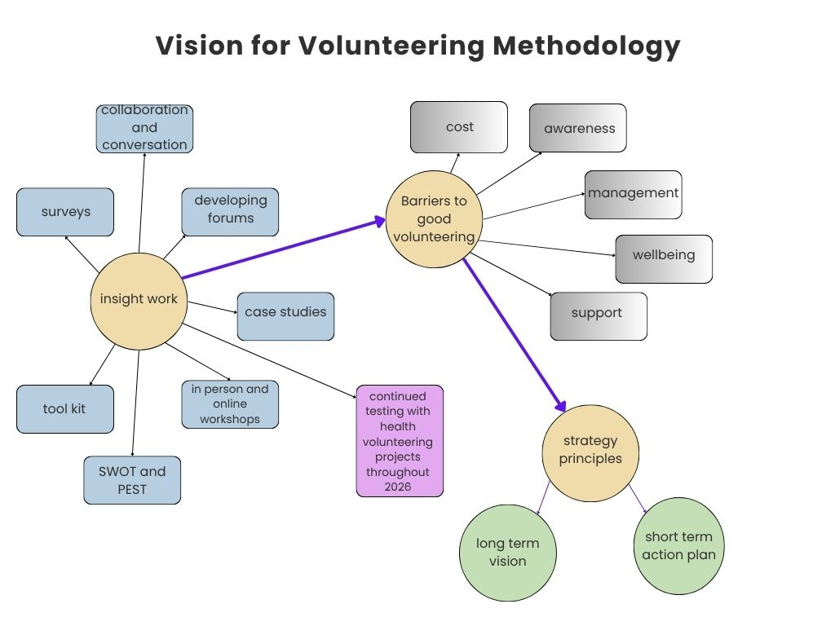

Slide 3
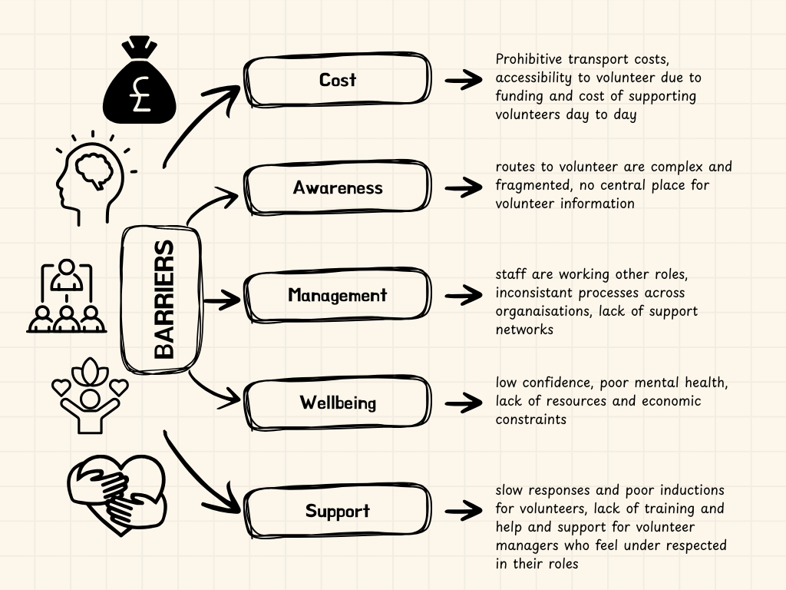
Barriers and gaps developed from insight work completed through discussions with our communities

Slide 4
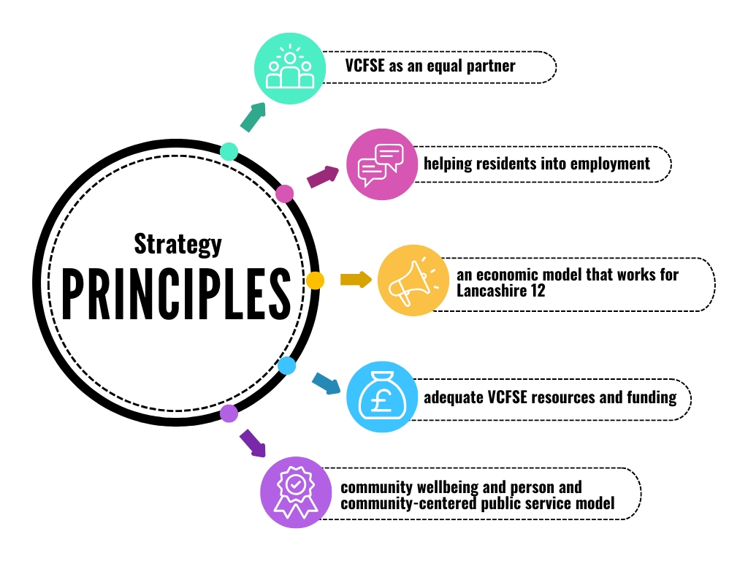
We have developed the strategy Principles from feedback and workshops.
We have also taken into consideration other regional and national strategies and work to evidence our strategy

Slide 5
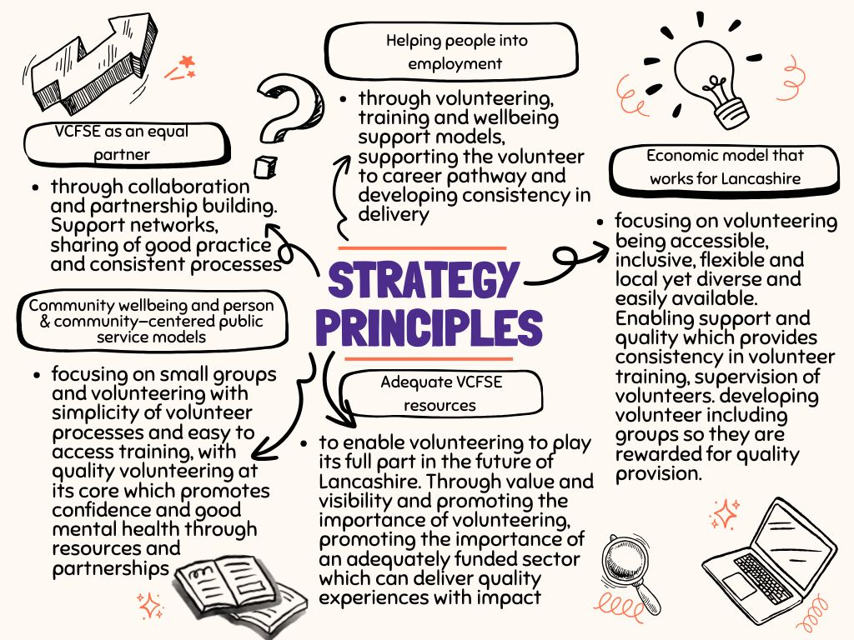
Strategy Principles Detail
Strategy Principles Detail

Slide 6
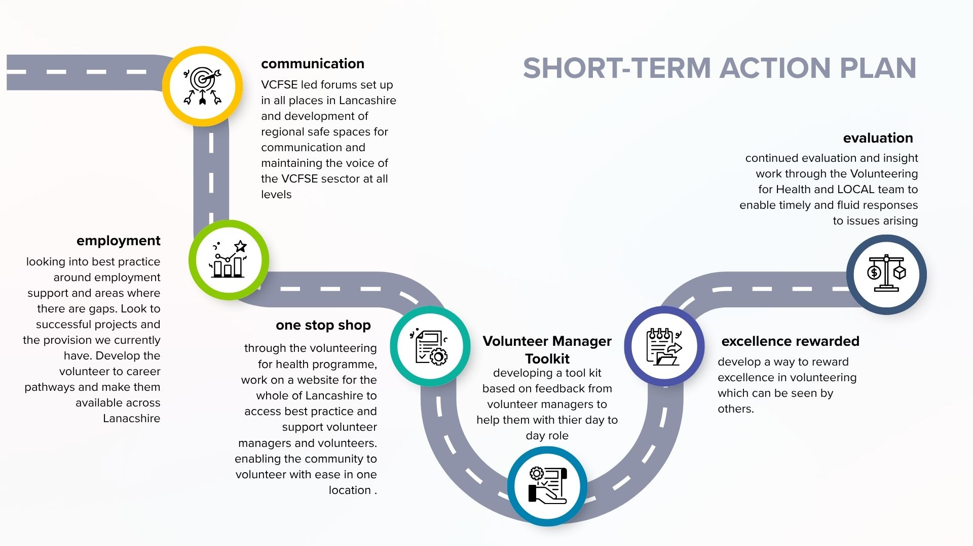

Slide 7
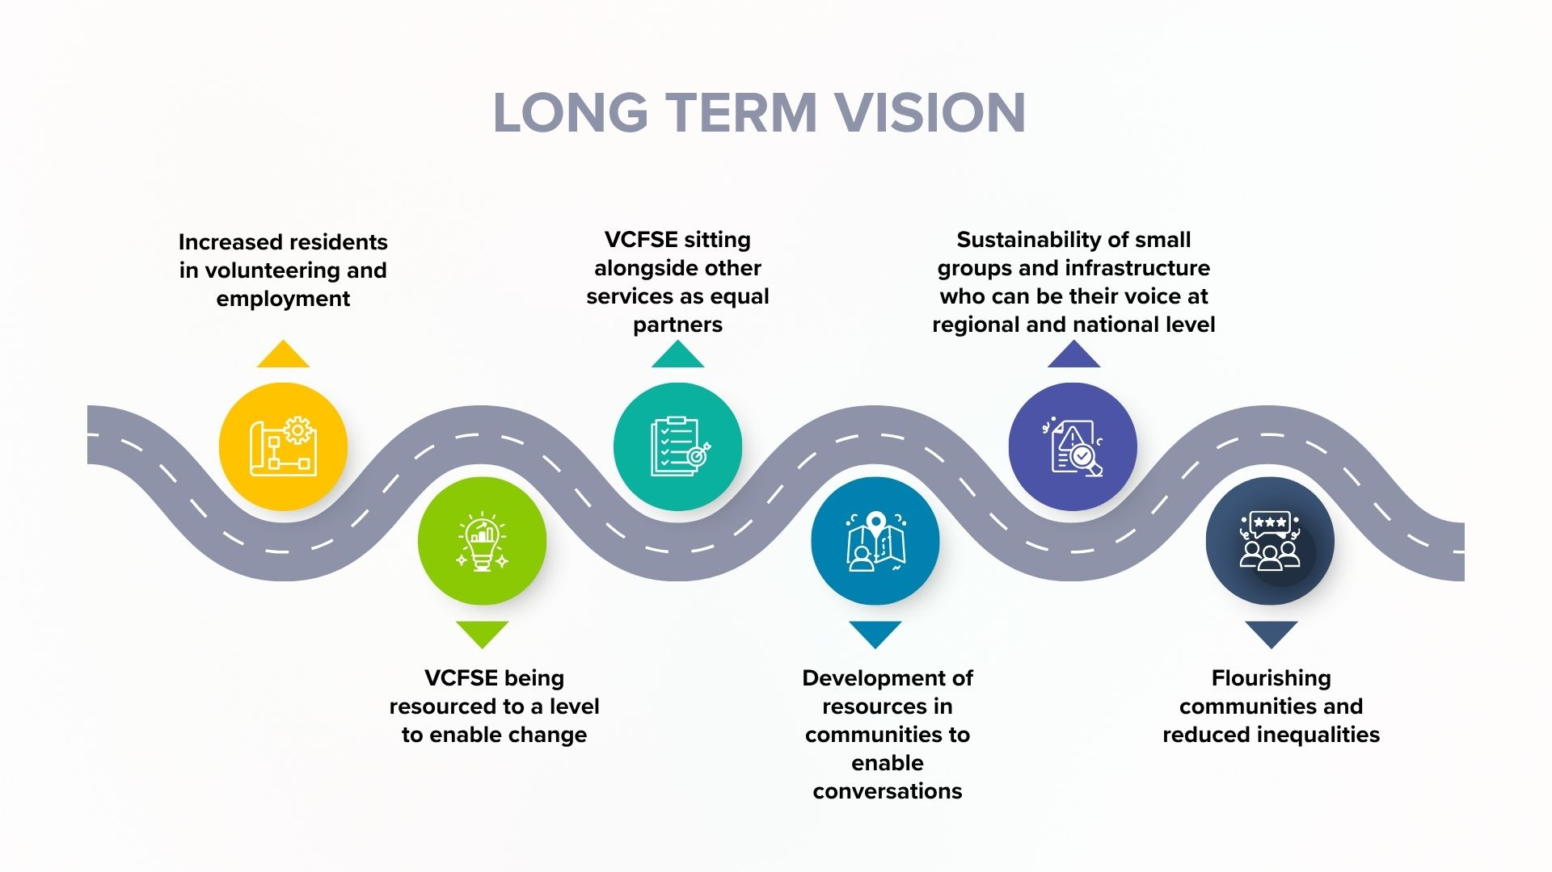

Slide 8

What impact do you feel the 6 short term action points being implemented over the next 18 months will have on you/ your organisation?
Do you feel there are any gaps in the strategy?
Is this a conversation you can be part of and support?
We are asking 3 questions of you….
To discuss further or to pass on any comments you may have please contact Lisa Ross,
LACVS Volunteering for Health Lead for Lancashire 12
lisa.ross@bprcvs.co.uk 01282 433740

